Slide 1


Automation Interview Preparation
By Suresh Thirumalai

Slide 2
Index
SNO | Topic | Slide Number
1 | Self Introduction | 3
2 | Framework Structure | 4
3 | Java | 8
4 | Programs | 17
5 | Selenium | 49
6 | Maven | 65
7 | POM | 67
8 | Singleton Design Pattern | 69
9 | Junit | 70
10 | TestNG | 56
11 | Cucumber | 89
12 | GIT | 90
13 | Jenkins | 92
14 | Data Driven | 93
15 | JDBC | 96
16 | SDLC | 99
17 | STLC | 100
18 | Manual Testing | 110
19 | Agile | 137
20 | JIRA | 160
21 | Interview Questions | 163

Slide 3
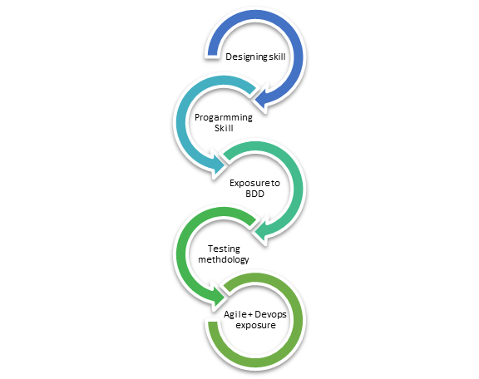
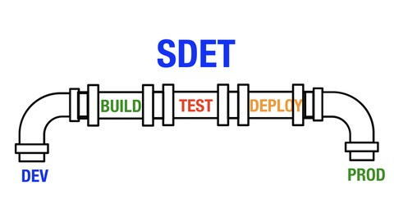
1. Self-Introduction
Name and City
Experience,
Company name
Position (Role)
Tools
Project Details
Name
Domain
Modules
Agile
Sprint

Slide 4
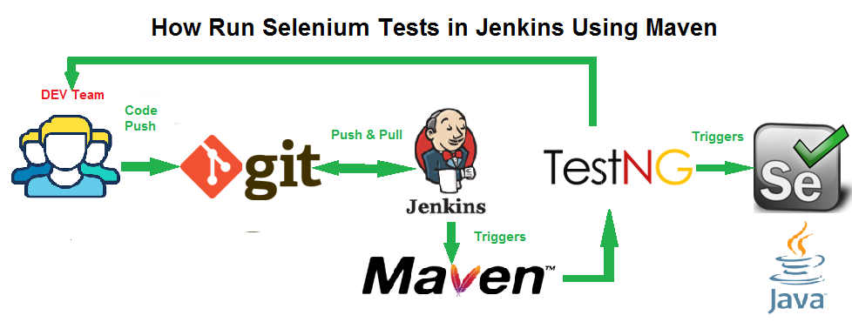

2. My Framework

Slide 5
My Tools
Maven
Selenium
Java
Cucumber
POM
Singleton
Library File
Property File
Driver Folder
Report Folder
GIT
Jenkins

Slide 6
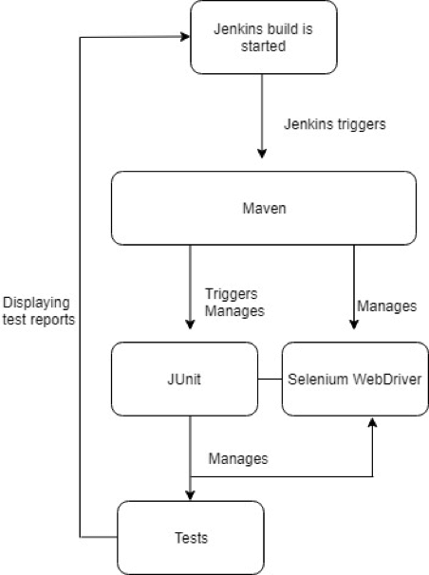
How tools interact:
1. Jenkins build is triggered,
2. Maven downloads the latest code changes and updates and performs the build.
Build goals runs the automated tests and that will take place through the maven-surefire-plugin.
3. The plugins tell Junit/TestNG to run all the tests in the Project that have the annotation @Test.
4. Once a test is found, the Selenium Webdriver comes into play, opens a new browser instance and runs the automated user interface test.
5. At the end of the build, a default report is generated by Jenkins with the results of the tests.

Slide 7
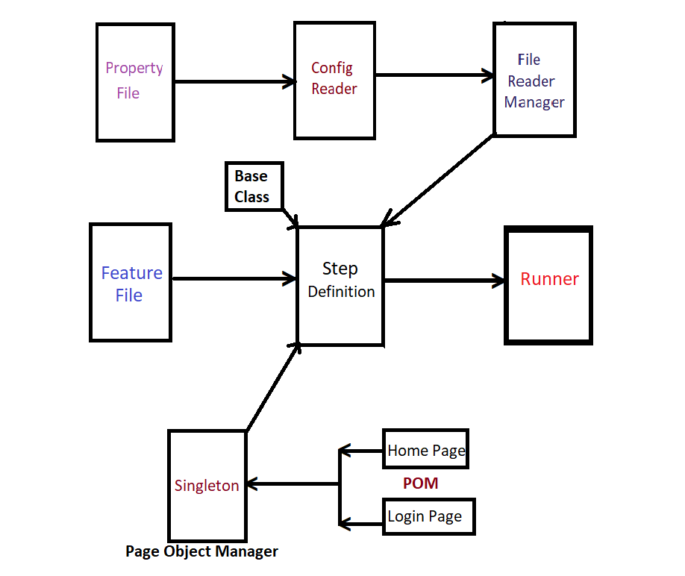

Framework Flow Chart

Slide 8
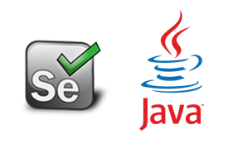

3. Java

Slide 9
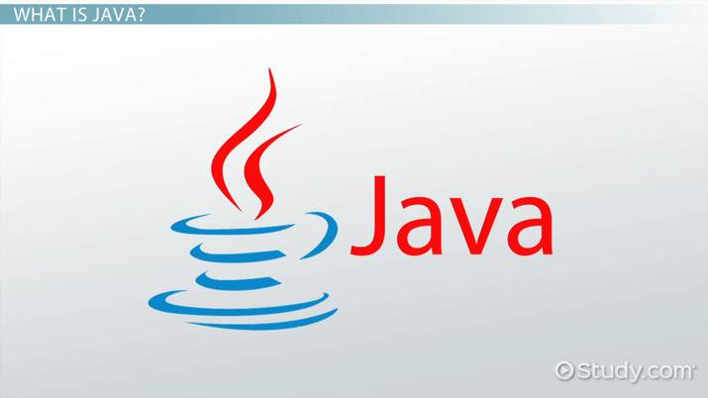
Level - 1 Questions
1. Why did you choose java?
2. What is the use of Java?
3. Why Java is platform independent?
4. Data types and Its Default Value?
5. Access modifiers?
6. What is OOPS? And Its Concepts?
7. Encapsulation?
8. Inheritance? And Its Types.
9. Why Multiple Inheritance is very Important?
10. Polymorphism? Its types and various names.

Slide 10
11. Constructor? And Its Types.
12. Abstraction? And Its types.
13. Abstract class Vs Interface ?
14. Variable and Its types.
15. Static ?
16. This vs Super ?
17. Final-Finally-Finalize ?
18. Throw vs Throws ?
19. For loop ? And Nested For loop?
20. While vs Do-while ?
Level - 2 Questions

Slide 11
21. Break vs Continue ?
22. Array and Its Methods ?
23. String and Its Methods ?
24. String Buffer vs String Builder ?
25. Immutable vs Mutable ?
26. Collection vs Collections ?
27. List vs Set vs Map ?
28. ArrayList vs LinkedList vs Vector ?
29. Hashset vs linkedHashSet vs TreeSet ?
30. HashMap vs HashTable ?
Level - 3 Questions

Slide 12
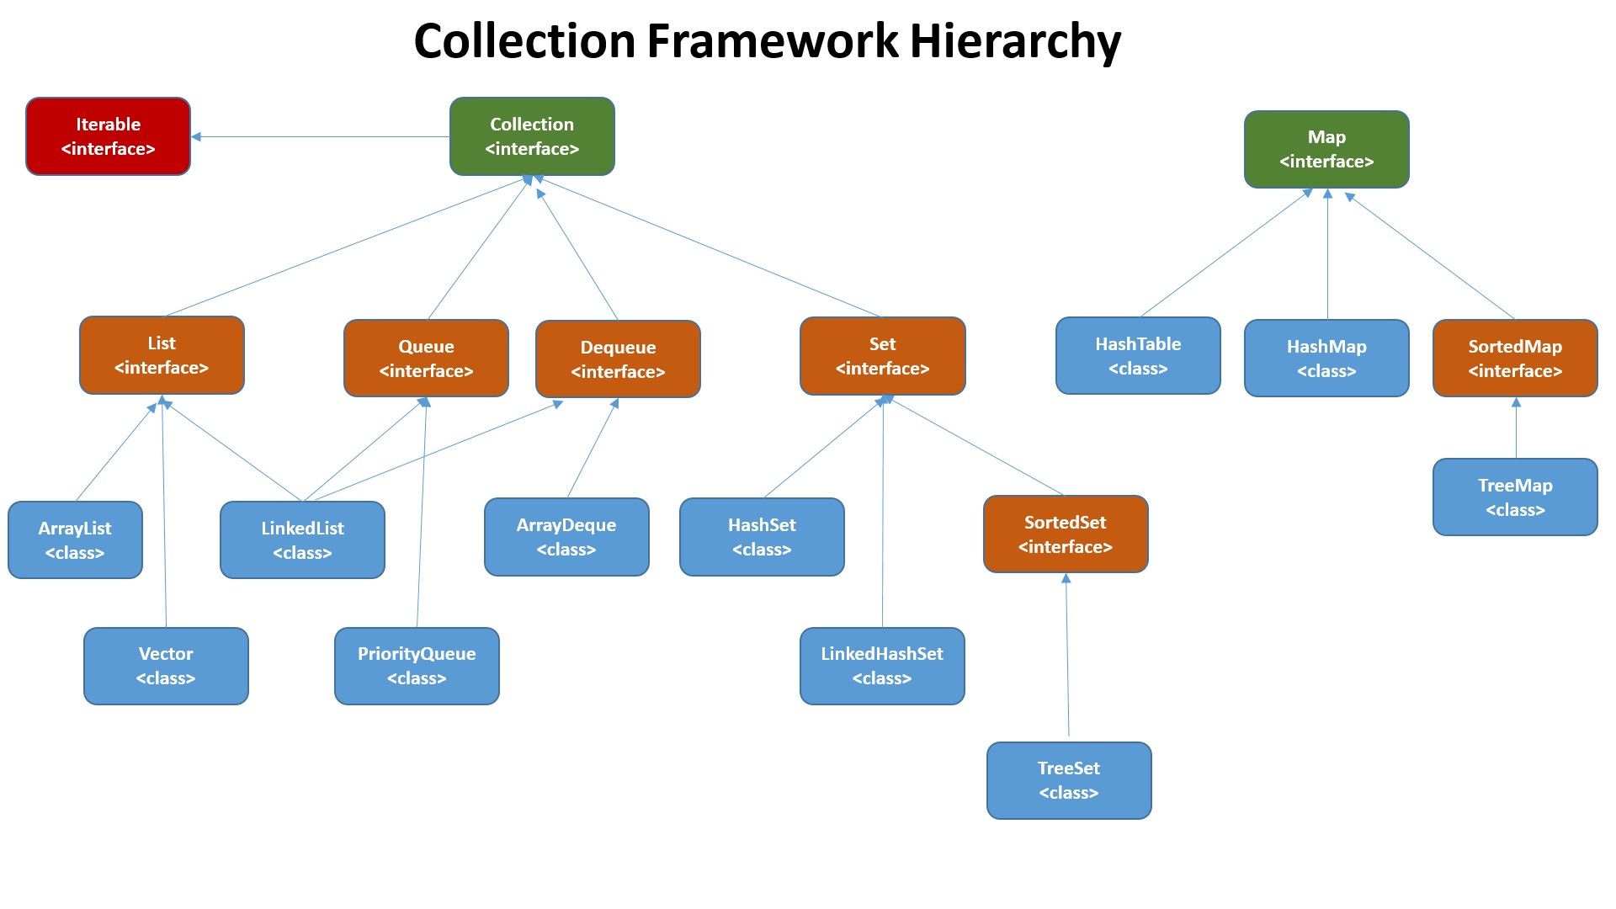

Slide 13
31. Array vs ArrayList
32. Iterator vs List Iterator ?
33. Exception vs Error ?
34. Customized Exception or User Defined Exception ?
35. Parent of all the Classes and Interfaces
36. Pre-increment vs Post-increment
37. Explain main method syntax? And, Can we change it?
38. Can static method be overridden?
39. Enum and Enumerator ?
40. Difference between Java 1.7 and 1.8 ?
Advanced
Level
Questions

Slide 14
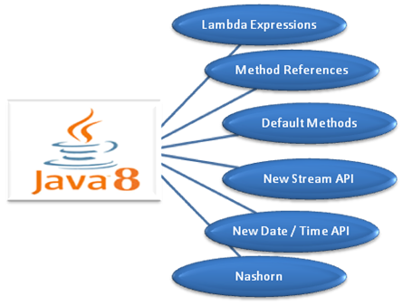
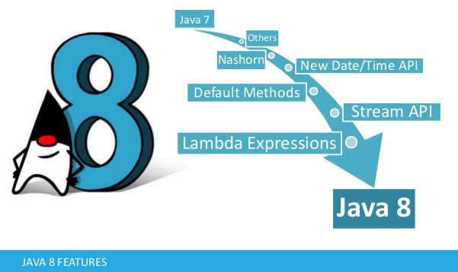

41. Java 8 Features:

Slide 15
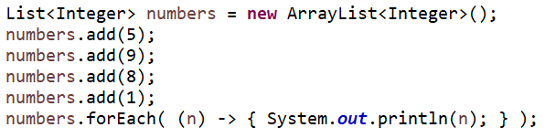

42. Lambda Expression
What is lambda expression ?
Ans:
A lambda expression is a method without a name, access specifier or return value declaration, (i.e) an anonymous method.
The following model represents the general structure of a lambda expression: (argument list) -> { body }

Slide 16
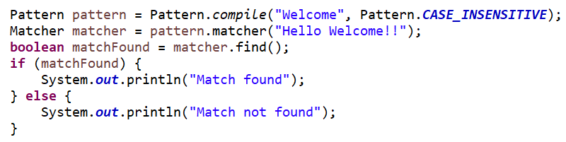
43. What is RegEx?
When you search for data in a text, you can use this search pattern to describe what you are searching for.
Regular expressions can be used to perform all types of text search and text replace operations

Slide 17
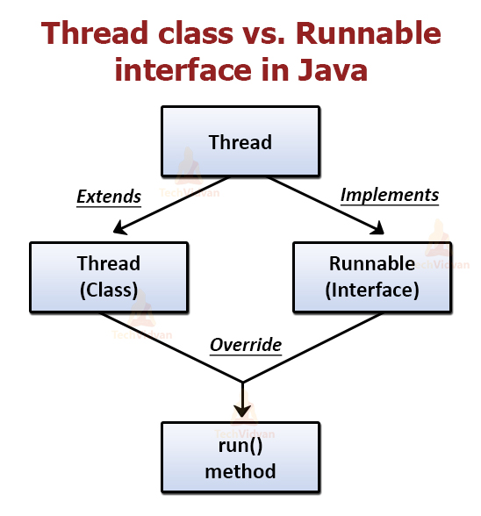
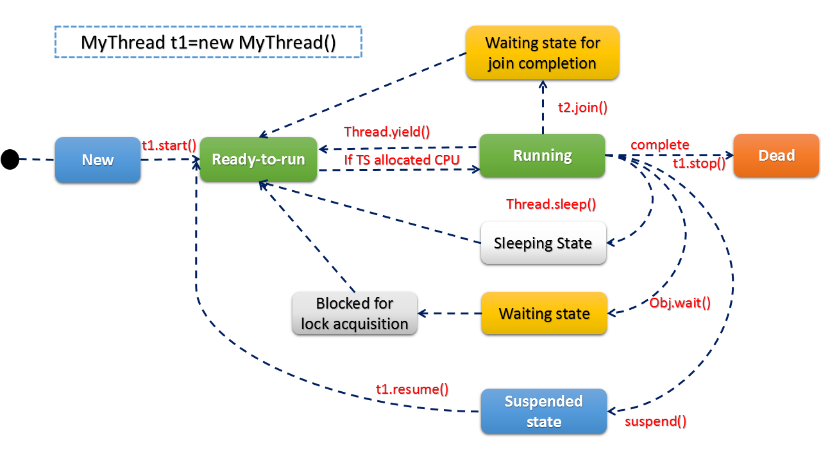

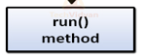
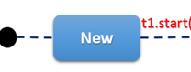
44. Multithreading concept

Slide 18
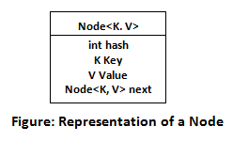
45. HashMap
HashMap contains an array of the nodes, and the node is represented as a class.
It uses an array and LinkedList data structure internally for storing Key and Value.
There are four fields in HashMap.

Slide 19
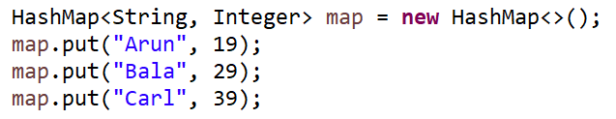
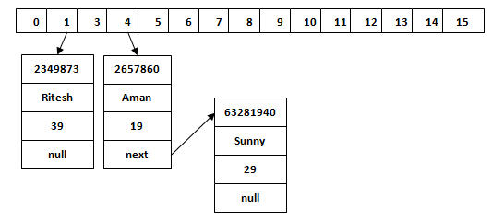
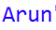
Data Structure Used in HashMap

Slide 20
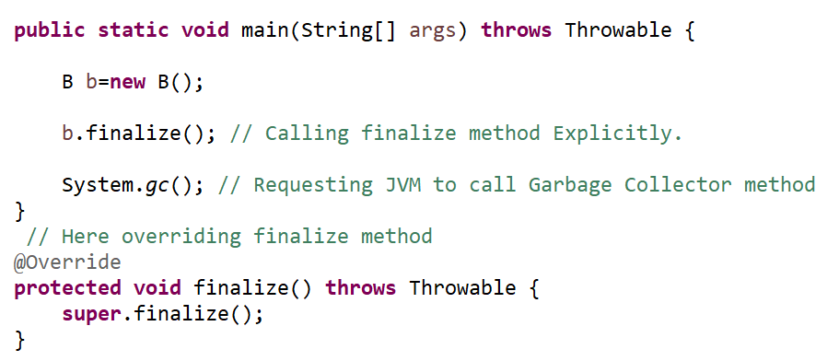
46. Finalize()
This method is used to perform some final operations or clean up operations on an object before it is removed from the memory

Slide 21
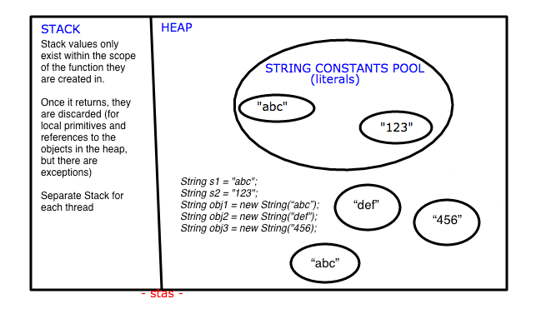

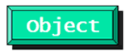
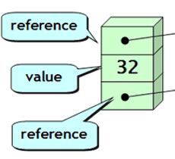

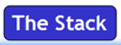

47. Stack vs Heap

Slide 22
48) Comparator vs Comparable
 | Comparable | Comparator
1 | Comparable provides a single sorting sequence. In other words, we can sort the collection on the basis of a single element such as id, name, and price. | The Comparator provides multiple sorting sequences. In other words, we can sort the collection on the basis of multiple elements such as id, name, and price etc.
2 | Comparable affects the original class, i.e., the actual class is modified. | Comparator doesn't affect the original class, i.e., the actual class is not modified.
3 | Comparable provides compareTo() method to sort elements. | Comparator provides compare() method to sort elements.
4 | Comparable is present in java.lang package. | A Comparator is present in the java.util package.
5 | We can sort the list elements of Comparable type by Collections.sort(List) method. | We can sort the list elements of Comparator type by Collections.sort(List, Comparator) method.

Slide 23

Java Concepts used in Our Automation Framework

Slide 24
Encapsulation
All the classes in a framework are an example of Encapsulation.
In POM classes, we declare the data members using @FindBy. And initialization of data members will be done using Constructor to utilize those in methods.
Encapsulation is a mechanism of binding code and data together in a single unit.

Slide 25
Inheritance
We create a Base Class in the Framework to initialize various Interfaces
WebDriver,
WebDriver waits,
TakeScreenshot,
JavaScript Executor,
Alert,
Action,
WorkBook,
WebElement,
Collection

Slide 26
Method Overloading
Example:
Here, we use different time stamps such as.
1. .frame(string), frame(int), frame(WebElement).
2. .findElement(“<All type of locator e.g. id , xpath , cssClass>”).
3. wait(), wait(timeout), wait(timout,nanos)
4. and WebDriverWait methods
5. implicit wait(SECONDS, MINUTES, HOURS)
Method Overloading:
A class having multiple methods with same name but different parameters.

Slide 27
Method Overriding
We use a method which was already implemented in another class by changing its data.
Examples:
- get() and navigate methods of different drivers in Selenium .
Method Overriding
Declaring a method in child class which is already present in the parent class.

Slide 28
Abstraction
In Page Object Model design pattern, We write locators (id, name, xpath etc.,) in a Page Class. We utilize these locators in tests but we can’t see these locators in the tests. Literally we hide the locators from the tests.
Abstraction: Methodology of hiding the implementation of internal details and showing the functionality to the users.

Slide 29
Abstract Class:
By
Interface:
WebDriver,
TakeScreenShot,
Alert,
SearchContext,
WebElement,
JavascriptExecutor,
Capabilities.

Slide 30
OOPS
Where did you use all the OOPS concept in your project?
Encapsulation
POM - declaring using @Findby and initializing using constructor
Inheritance
Baseclass is extended in Step Definition
Polymorphism
Method overloading - implicit wait
Method overriding - get(“url”)
Abstraction
Abstraction - POM - hiding the data
Interface – Web driver

Slide 31
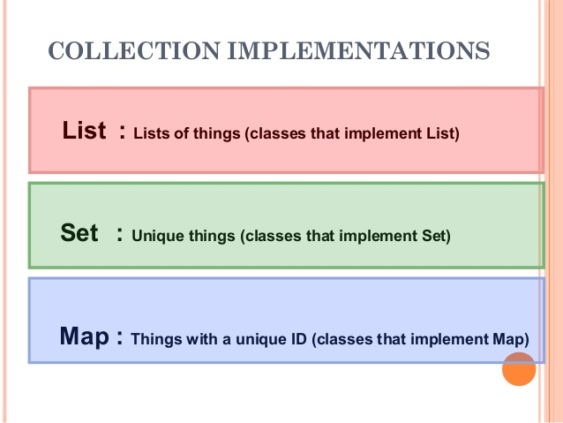
Java Collection Usage in Selenium

Slide 32
4. Programs
1. Repetitive words
2. Reverse a String
3. Prime Numbers
4. Triangle
5. Duplicates in Array
6. Recursion
7. Alphabet, Digits, Special Characters from String
8. Armstrong,
9. Palindrome , Reverse a Number
10. Fibonacci Series
11. Sorting, (Max, Min)
12. Swapping
13. Array rotation
14. Remove Spaces from String

Slide 33
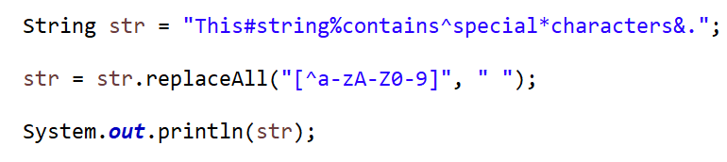
14. Remove Special Characters

Slide 34




5. Selenium
Introduction
Costs and Flexibility:
more Advantageous
It also allows to run tests in parallel
(Quick Test Professional)
Allows to run tests sequentially.

Slide 35
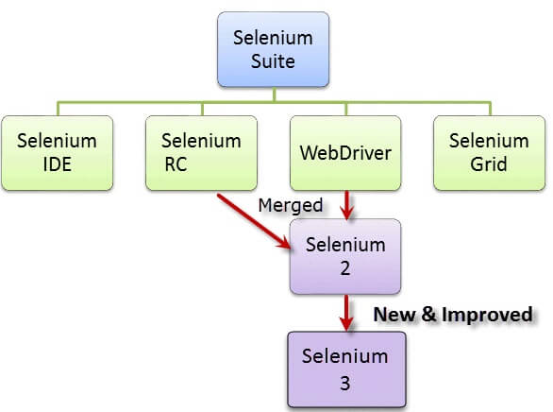
1) Selenium Components

Slide 36
a) Selenium IDE
Can use it in Firefox Only.
Can use for simple test cases and test suites

Slide 37
b) Selenium RC
Also known as Selenium 1,
Allows users to use programming languages in creating complex tests.

Slide 38
c) Selenium WebDriver,
This Interface is used as Automation Framework Tool
It is used to automate web application testing to verify that it works as expected.
supports many browsers such as Chrome, IE, Firefox, Safari
Enables to use a programming language like Java, c#, Groovy, Perl, PHP, Python and Ruby.

Slide 39
d) Selenium Grid
Running multiple tests across different browsers,
operating systems,
and machines simultaneously
Save time in the execution of your test suites
Uses a hub-node concept
Test:
Running in single machine (hub),
But the execution in different machines (nodes.)

Slide 40
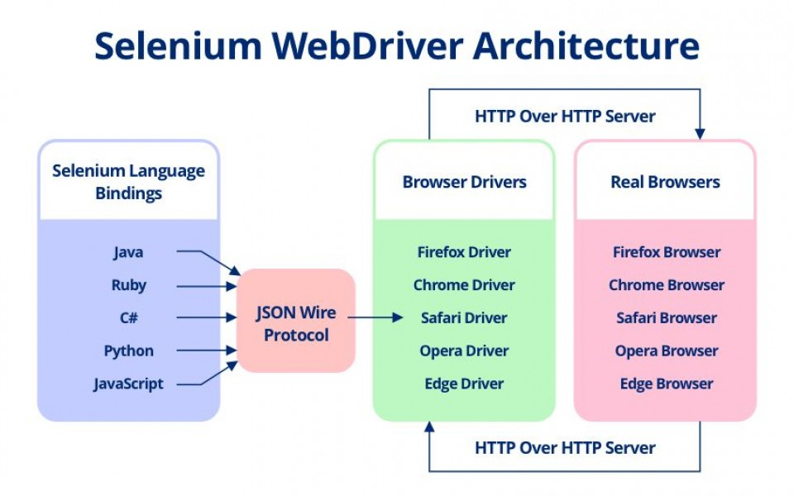

2) Selenium Architecture

Slide 41
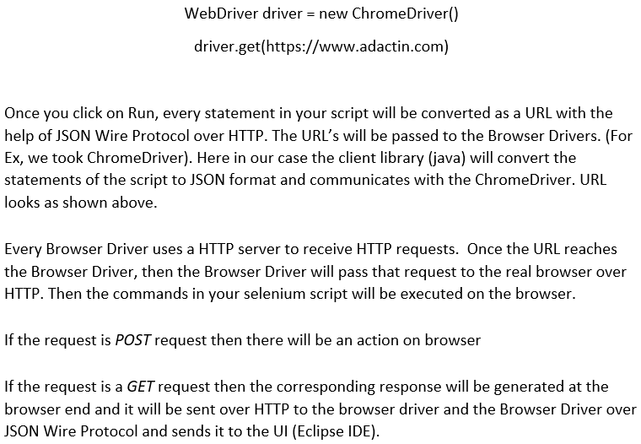
Explanation:

Slide 42
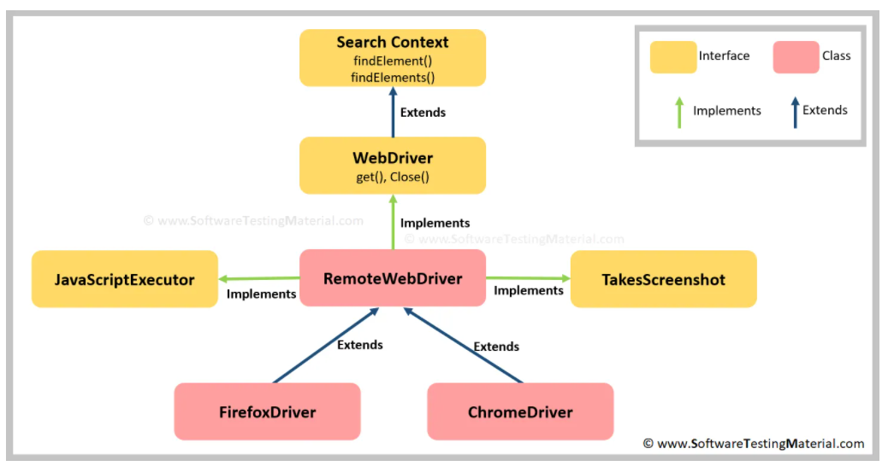
Back End Process of ChromeDriver

Slide 43
3) Browser Launch
Basic statement we all know in Selenium is
WebDriver driver = new ChromeDriver();
Interface obj = new Class
Here, we are initializing Chrome browser using Selenium WebDriver. So in the above statement, we are actually telling ChromeDriver class that “Hey you can automate the various methods that you want on the chrome browser. For that, we declare a reference variable of type WebDriver and then use it to instantiate ChromeDriver.
ChromeDriver class already has the implemented version of methods in WebDriver.

Slide 44
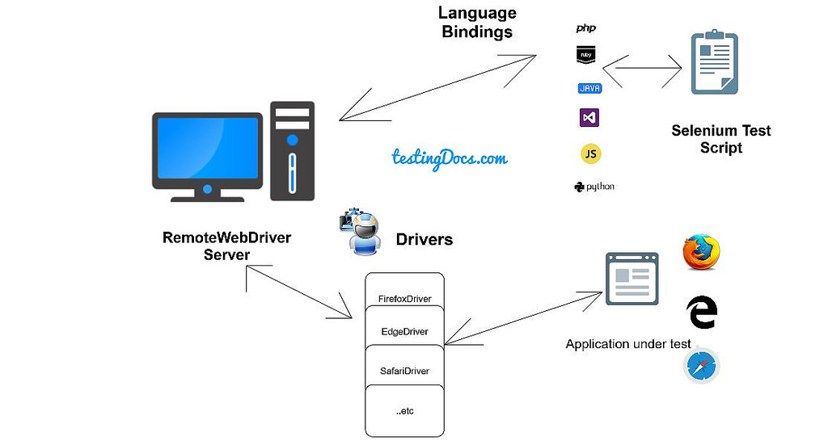

RemoteWebDriver

Slide 45
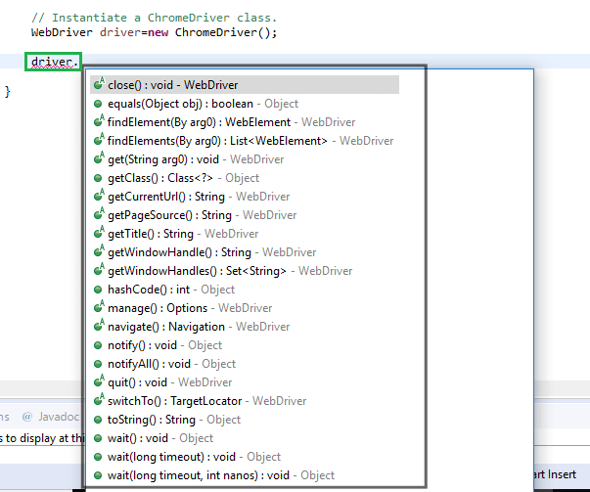
4) Driver Methods

Slide 46
Driver method Questions:
Find Element vs Find Elements (and Its return type)
Get vs navigate
Close vs Quit
Switch To
Alternative to get
Alternative to sendkeys
Current Url vs Title

Slide 47
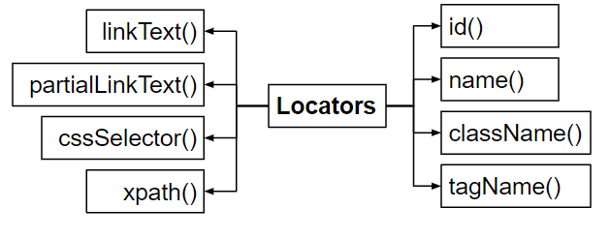

5) Selenium Locators
Selenium Locators are used to identifying the web elements on the Web page.

Slide 48
6) X-Path
1. Absolute
2. Relative

Slide 49
1. Absolute X-Path
It begins with the single forward slash(/) ,
we can select the element from the root node.
Eg: html/body/div[1]/selection/div[1]/h4[1]/b

Slide 50
2. Relative X-Path
Starts from the middle of the HTML DOM structure.
It starts with the double forward slash (//),
It can search the element anywhere at the webpage.
Eg: //*[Class=‘feature-box’]

Slide 51
Dynamic X-Path:
Text
Contains
Starts-with
//td[text()=‘message’]
//*[contains(@id, ‘message’)]
//label[starts-with@id,’message’]

Slide 52
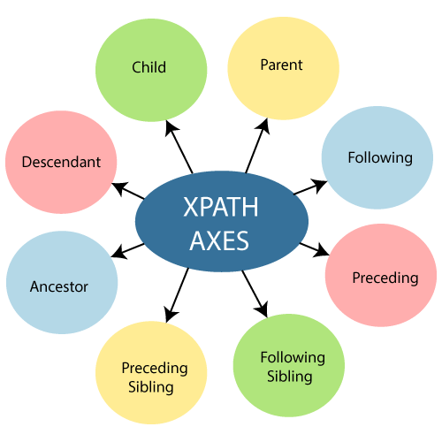
Axes Methods

Slide 53
Xpath Axes Methods
Following
Preceding
Child
Ancestor
Following-sibling
Preceding-sibling
Parent
Descendant
//*[@type=‘submit’]//following::input[1]
//*[@type=‘submit’]//preceding::input[1]
//*[@type=‘submit’]//child::input[1]
//*[@type=‘submit’]//ancestor::input[1]
//*[@type=‘submit’]//following-sibling::input[1]
//*[@type=‘submit’]//preceding-sibling::input[1]
//*[@type=‘submit’]//parent::input[1]
//*[@type=‘submit’]//descendant::input[1]

Slide 54
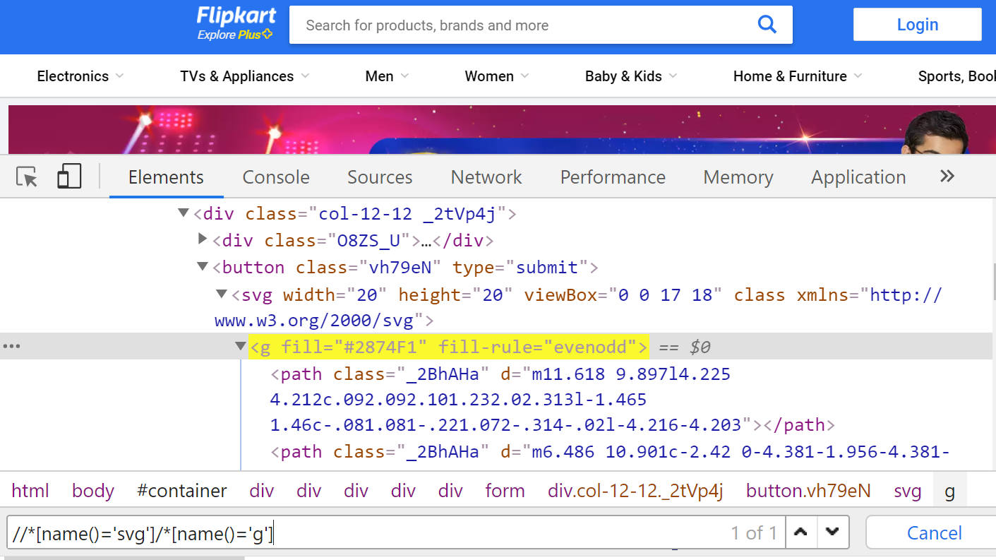
How to get xPath for SVG elements?
SVG stands for scalable vector graphics, and it is a file format that allows you to display vector images on your website.
"/*[name()='svg']/*[name()='SVG OBJECT']"

Slide 55
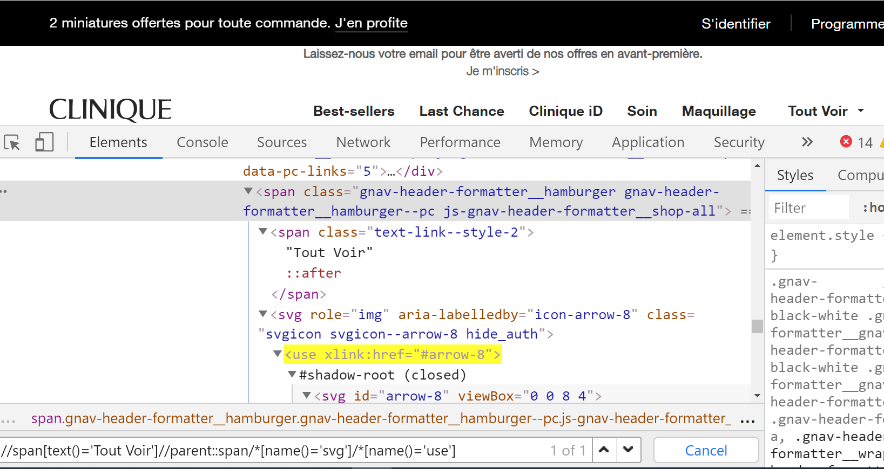
Dynamic xpath with svg element

Slide 56
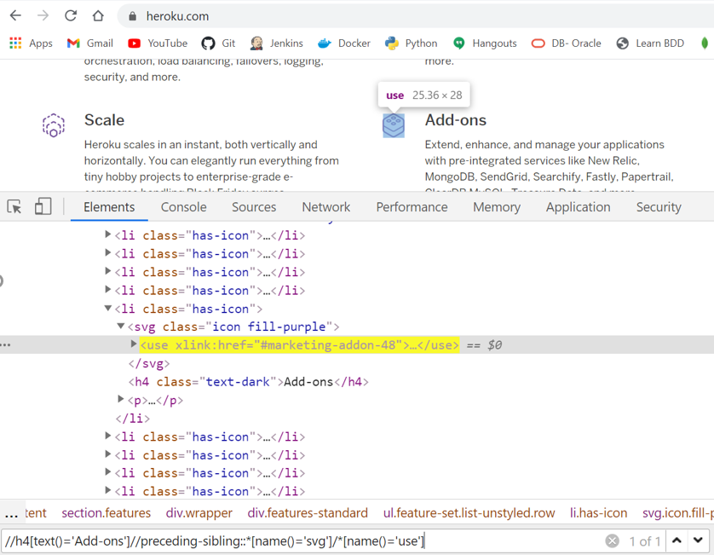

Slide 57
7) CSS Selector - Cascading Style Sheet
It is easier to learn/understand
Typically faster than Xpath.
It is used a lot on the development side to style web pages.
we can find / select HTML elements on the basis of their id /class / attributes
Syntax:
tagName[attributename=attributeValue]
tagName#idattributeValue
tagName.classattributeValue
tagName.classattributeValue1.classattributeValue2

Slide 58
How to verify text color in selenium?
We can use .getCssValue() method
element.getAttribute("background") element.getAttribute("style") element.getAttribute("background-color") element.getCssValue("style")
element.getCssValue("color")

Slide 59
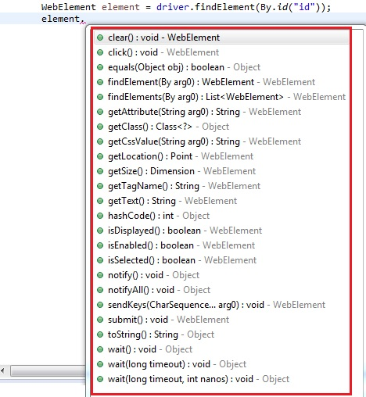
8) Web Element Methods

Slide 60
Web Element methods Questions
Get Attribute vs Get Text
Get Attribute:
1. To get value of the attribute
2. To get the input value that we passed into a textbox
Get Text:
To get text of web element.
Is Enabled ---> editable/clickable ??
Is Displayed ---> Visible/available??
Is Selected ---> Selected??

Slide 61
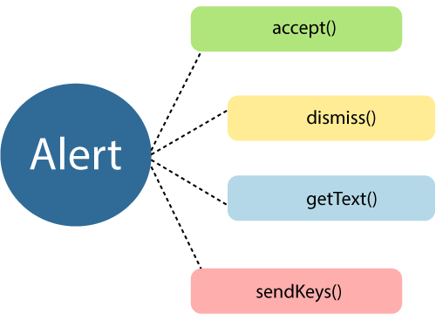
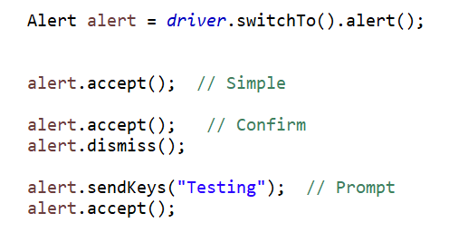
9) Alert/Pop up
Simple
Accept()
Confirm
Accept() or dismiss();
Prompt
Sendkeys() & accept()

Slide 62
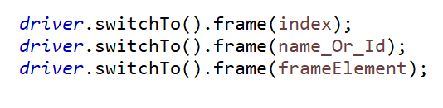
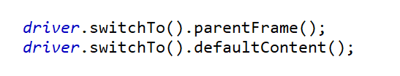
10) Frames
Parameters:
index
Name / Id
Element
Parent frame and Default Content

Slide 63

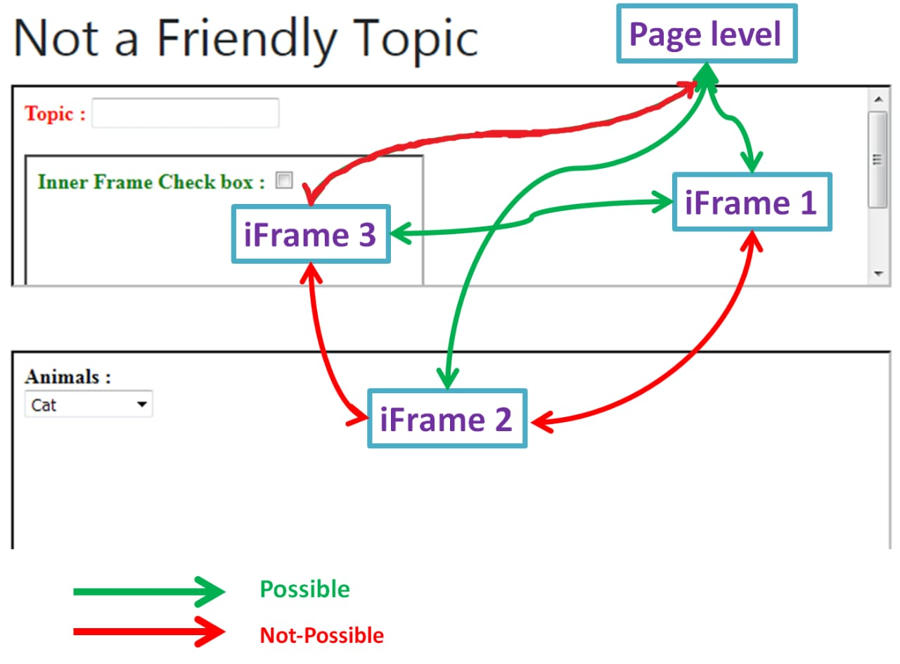
Nested Frames

Slide 64
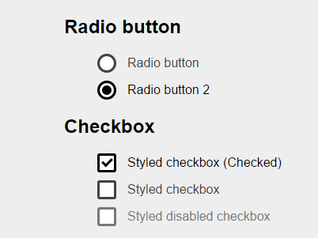
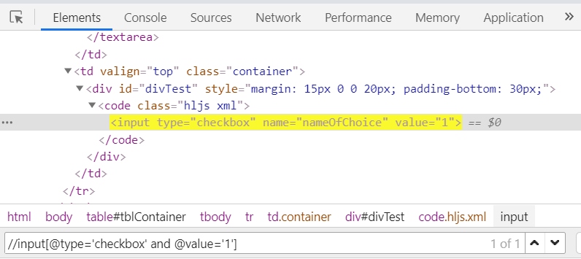
11) Check Box

Slide 65
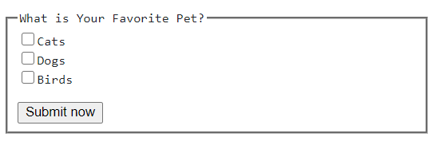
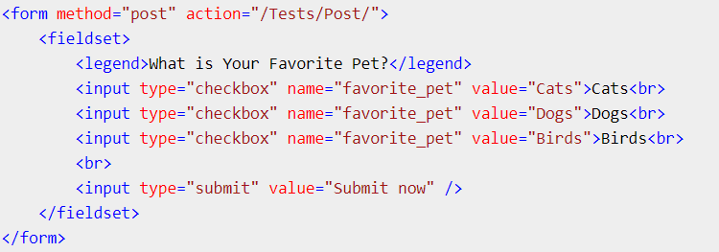
Multiple Check Boxes
DOM

Slide 66
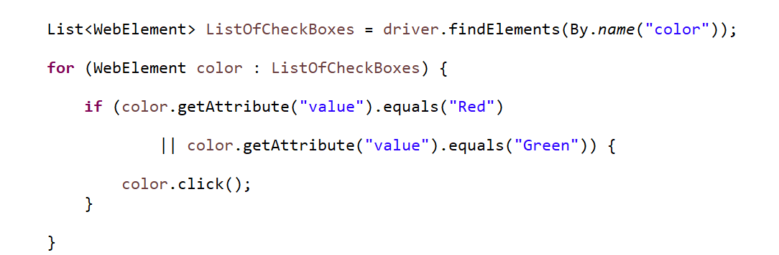
Code

Slide 67
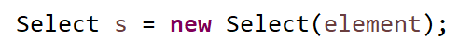
12) Drop Down
Select s=new Select(element)
s.selectByIndex(14);
s.selectByValue(“March”)
s.selectByVisibleText(“1996”)

Slide 68

Multiple Drop Down

Slide 69

How to verify selected value from Dropdown ?

Slide 70

How to get all Options from Dropdown?

Slide 71


Actions Class
Action Class is a built-in feature provided by the selenium for handling keyboard and mouse events.
Frequently used Keyword and Mouse Events are doubleClick(), keyUp, dragAndDropBy, contextClick & sendKeys.

Slide 72
Build() vs Perform()
build()- Builds the sequence of actions.
- Thus build() method is used compile all the listed actions into a single step. We use build() when we are performing sequence of operations and no need to use if we are performing single action.
perform()- Performs the currently built action.
- perform() this method in Actions Class is use to execute chain of action which are build using Action build method.

Slide 73

Actions –DropDown - Alert – Frame – Checkbox

Slide 74



13) Web Table
<td>
<td>

Slide 75

Dynamic Web Table
Three Important things
1. Size
2. Normal For loop
3. Find Index of Title
----------------------------------------------------------------------------------------------------------------

Slide 76

14) Wait a Definition - Syntax - Difference
Implicit - It commands to wait for a certain amount of time before throwing a “No such element” exception.
Explicit - It is used to tell the Web Driver to wait for certain conditions before throwing an "ElementNotVisibleException" exception

Slide 77

Fluent Wait
Fluent - It commands to wait for a condition, as well as the frequency with which we want to check the condition before throwing an "ElementNotVisibleException" exception
-----------Synchronization in Selenium-------------

Slide 78




15) JavaScript Executor:
In case, the locators do not work,
- We can use it to perform a desired operation on a web element.
If Selenium Web driver fails to click on any element due to some issue,
- We can use it

Slide 79




JavaScript Executor
It is an Interface :
- helps to execute JavaScript through Selenium Web driver.
JavaScript Executor provides 2 methods
- "executescript" & "executeAsyncScript.

Slide 80

Examples: JavaScript

Slide 81

16) Robot Class
Robot Class can stimulate Keyboard and Mouse Event
Methods
KeyPress()
KeyRelease()
mousePress()
mouseRelease()
mouseMove()

Slide 82

17) Windows Handling

Slide 83


Multiple window Handling
Switch to the window to get the title.
Switch to window one by one to get all the titles.

Slide 84
18) What are the exceptions you have handled in your project?
1. WebDriverException
2. NoSuchElementException
3. NoSuchWindowException
4. NoSuchFrameException
5. NoAlertPresentException
6. InvalidSelectorException
7. ElementNotVisibleException
8. ElementNotSelectableException
9. ElementNotInteractableException
10. TimeoutException

Slide 85


19) StaleElementReferenceException
Stale Element means an old element or no longer available element.

Slide 86
When:
Assume:
There is an element found on a web page, referenced as a WebElement in WebDriver.
Now the DOM changes and then WebElement goes stale.
If we try to interact with an element which is staled, then this SERE Exception is thrown.
StaleElementReferenceException: Element reference (e754b65) is stale either the element is no longer attached to the DOM, it is not in the current frame context, or the document has been refreshed.

Slide 87
Reasons:
1. Document navigation
Upon navigation, all web element references to the previous document will be discarded along with the document. This will cause any subsequent interaction with the web element to fail with the stale element reference error.
2. Node removal: (AJAX Call)
When a document node is removed from the DOM, its web element reference will be invalidated.

Slide 88
How to fix StaleElementReferenceException ?
1. Refresh the page and try again for the same element.
2. Use ‘try-catch block’ within ‘for loop’
3. Wait for the element till it gets available
wait.until(ExpectedConditions.presenceOfElementLocated(By.id("table")));
4. Use ExpectedConditions.refreshed to avoid SERException and retrieve the element again. This method updates the element by redrawing it and we can access the referenced element.
wait.until(ExpectedConditions.refreshed(ExpectedConditions.stalenessOf("table")));
5.

Slide 89



20) Class Hierarchy

Slide 90

21) Interface Hierarchy

Slide 91
22) Debugging Techniques
1. Step by Step Debugging Using Breakpoints
Using Breakpoints (Shift+Ctrl+B)
F5 - Step Into
F6 - Step Over
F7 - Step Return
F8 - To next breakpoint

Slide 92


2. Logger

Slide 93



Slide 94
23) Desired Capabilities
DesiredCapabilities are options that you can use to customize and configure a browser session
ChromeOptions class has introduced in the latest/updated version of Selenium. It is helpful to make changes in the Chrome browser.
DesiredCapabilities is an old concept (its usage in Java is deprecated.) to configure or make changes in the browser.
But we can use both DesiredCapabilities and Chromeoptions class via merge method.
options.AddArgument("--test-type"); options.AddArgument("--disable-extensions"); options.AddArguments("disable-infobars"); options.AddArguments("--disable-notifications"); options.AddArguments("enable-automation"); options.AddArguments("--disable-popup-blocking"); options.AddArguments("start-maximized");

Slide 95

Desired Capabilities in Appium

Slide 96

24) Broken Links:
Broken links are links or URLs that are not reachable.
They may be down or not functioning due to some server error
How to check the Broken Links images:
1. Collect all the links in the web page based on <a> tag.
2. Send HTTP request for the link and read HTTP response code.
3. If response code is >=400, then it is broken based.
4. Repeat this for all the links captured.

Slide 97

Output

Slide 98

25) Highlight Element
We can highlight a Web Element during the runtime Using JavaScript Executor

Slide 99

Alternative to Click()
1.
2. WebElement.sendKeys(Keys.ENTER);
3. Actions ac = new Actions(driver);
ac.moveToElement(element).click(element);
ac.perform();

Slide 100

Alternative to Sendkeys()

Slide 101
Implicit wait + Explicit wait
Mixing explicit waits and implicit waits will cause unintended consequences, namely waits sleeping for the maximum time even if the element is available or condition is true.
Warning: Do not mix implicit and explicit waits. Doing so can cause unpredictable wait times. For example, setting an implicit wait of 10 seconds and an explicit wait of 15 seconds could cause a timeout to occur after 20 seconds.

Slide 102


WebDriver Manager

Slide 103



6. Maven

Slide 104
Maven - Introduction
Maven is a powerful project / build management tool,
- Based on the concept of a pom.xml (Project Object Model)
- Includes project info & configuration info
Use:
Dependency,
Plugins,
Goals,
etc.

Slide 105


Maven Architecture

Slide 106
1) Build Life Cycle
Clean
To clean the Project
To remove all the files generated by previous build
Build
This is the main life cycle
It is responsible for project deployment
Site
To create the project’s site documentation

Slide 107

2) Phases - Overview
Clean (3) Build (23) Site (4)

Slide 108
Phases:
It represents a stage in Maven build lifecycle.
Each phase is responsible for specific task.
This will not only execute specified phase but all preceding phases as well

Slide 109
Phases and their tasks
validate - check if all info necessary for the build is available
compile - compile the source code
test-compile – compile the test source code
test - run unit tests
package - package compiled source code into their distributable format (jar/war)
integration-test - process and deploy the package if needed to run integration tests
install - install the package to the remote repository
deploy - copy the package to remote repository
eg: mvn deploy

Slide 110
Important Phases and reflection in folders
Clean: - Target folder will be deleted.
Validate: - To validate whether everything is correct or not in the project and any information is available or not.
Compile: - Class file will be created inside the target folder.
Test-compile: - Test-classes folder will be created.
Test: - Surefire-reports folder will be created. Text and xml files.
Install: - It will create executable jar file

Slide 111
3) Goals
Each phase is a sequence of goals, and each goal is responsible for a specific task
When we run a phase – all goals bound to this phase are executed in order.
Here are some of the phases and default goals bound to them:
compiler:compile – the compile goal from the compiler plugin is bound to the compile phase
compiler:testCompile is bound to the test-compile phase
surefire:test is bound to test phase
install:install is bound to install phase
jar:jar and war:war is bound to package phase

Slide 112
Phase and its all goals
We can list all goals bound to a specific phase and their plugins using the command:
For example, to list all goals bound to the compile phase, we can run:
And get the sample output:
compile' is a phase corresponding to this plugin:
org.apache.maven.plugins:maven-compiler-plugin:3.1:compile
Which means the compile goal from compiler plugin is bound to the compile phase
 | mvn help:describe -Dcmd=compile

Slide 113

4) plugin
A Maven plugin is a group of goals
However, these goals are not necessarily all bound to the same phase.
For example, Maven Surefire plugin which is responsible for running the tests

Slide 114
Ex: Failsafe plugin
we can see, the Failsafe plugin has two main goals configured here:
integration-test: run integration tests
verify: verify all integration tests passed
We can list out all goals in a specific plugin:

Slide 115


For example, to list all goals in the Failsafe plugin:
mvn failsafe:help
And the output of this will be:
This plugin has 3 goals:
1
2
3

Slide 116
A goal and its particular phase
To run a specific goal, without executing its entire phase (and the preceding phases)
For example, to run integration-test goal from Failsafe plugin, we need to run:
 | mvn failsafe:integration-test

Slide 117
6. Building a Maven Project
To build a Maven project, we need to execute one of the life cycles by running one of their phases:
This will execute the entire default lifecycle. Alternatively, we can stop at the install phase:
But usually we'll use the command:
To clean the project first – by running the clean lifecycle – before the new build.
We can also run only a specific goal of the plugin:
Note that if we tried to build a Maven project without specifying a phase or a goal, that will cause the error:
 | mvn deploy
 | mvn install
 | mvn clean install
 | mvn compiler:compile
 | [ERROR] No goals have been specified for this build. You must specify a valid lifecycle phase or a goal

Slide 118
Pom.xml
Fundamental unit of work In Maven
It is an XML File that contains information about project and configuration details used by Maven to build the project.
Describes a Project
Name & version, Artifact Type, Source Code Locations, Dependencies
Plugins
Profiles
Uses XML by Default
Not the way Ant uses XML

Slide 119
7. Page Object Model
It is a design pattern to create Object Repository for web UI elements.
Each web page in the application, there should be corresponding page class.
This Page Class - WebElements of that web page
- Page methods - perform operations on those W.E
1. It is an Object Repository design pattern in Selenium WebDriver.
2. POM creates our testing code maintainable, reusable.
3. Page Factory is an optimized way to create object repository in POM concept.

Slide 120
Page Factory (class):
We use annotations @FindBy to find WebElement.
We use initElements method to initialize web elements
Instead of using driver.findElements();
@FindBy @FindBys @FindAll
- @FindBys : When the required WebElement objects need to match all of the given criteria use @FindBys annotation
- @FindAll : When required WebElement objects need to match at least one of the given criteria use @FindAll annotation

Slide 121
Use of POM
Page Object Model, also known as POM is a design pattern in Selenium that creates an object repository for storing all web elements.
It is useful in reducing code duplication
It improves test case maintenance.
In Page Object Model, consider each web page of an application as a class file.

Slide 122
8. Singleton Design Pattern
A Class must ensure that single instance should be created
Single Object can be used by all other classes wherever required
Definition:
A class that has only one instance and provides a global point of access to it
How to create?

Slide 123
How SDP is implemented
In 2 places
1. FileReaderManager
2. PageObjectManager

Slide 124


How to create Singleton?
FileReaderManager

Slide 125
Use of Singleton Design Pattern
Singleton pattern restricts the instantiation of a class and ensures that only one instance of the class exists in the java virtual machine.
The singleton class must provide a global access point to get the instance of the class.

Slide 126
9. JUnit
JUnit is an open source Unit Testing Framework for JAVA. It is useful for Java Developers to write and run repeatable tests.
Annotations:
@BeforeClass
@Before
@Test
@After
@AfterClass
Assertion
Assert Methods
Eg: Assert.assertEquals(String1, String2);

Slide 127
10. TestNG
Testing Framework inspired from Junit
Having new functionalities makes more powerful and easier to use
Separates compile-time test code from run-time configuration

Slide 128

TestNG Architecture

Slide 129
Features
1. Simple Annotations
2. Ignore Test (Enable / Exclude)
3. Priority based Test
4. Group Test
5. Dependency Test (Methods / Groups)
6. Multiple times (Invocation count)
7. TimeOut
8. Exception Test
9. Parameterized Test
10. Data Provider
11. Parallel testing
12. Cross browser testing
13. Testng-failed.xml
14. RetryAnalyzer
15. Report
16. Junit Test

Slide 130

testng.xml
Tag <suite> : It is represented by one XML file.
It can contain one or more tests
Tag <test> : It represents one test
It can contain one or more TestNG classes.
Tag < class > : It represents a TestNG class. It is a Java class.
It contains at least one TestNG annotation.
It can contain one or more test methods.

Slide 131
What is <suite> ?
Root tag of testng.xml
It has several <test> sections
Legal Attributes:
Name : Name of the suite. (Mandatory)
Verbose: level or verbosity for this run
Parallel: different threads to run this suite
Thread-count :number of threads to use, Only if parallel mode is enabled.
Time-out : default timeout

Slide 132

1. Annotations (STGCM)

Slide 133
2. Ignore Test
enabled (True/False)
Ex:
@Test(enabled=False)
(or)
@Ignore
(or)
exclude in testing XML

Slide 134



Ex: enables & exclude

Slide 135
3. Priority
First preference: Non-prioritized methods
Second preference: Prioritized methods:
- lower priority value will be executed first.
Note: Methods with same priority:
- Alphabetical order
No change in XML file

Slide 136



Ex: Priority

Slide 137


4. Group Test

Slide 138


Group of Groups(MetaGroups) & exclusion of Group

Slide 139
5. Dependency Test
Sometimes, you may need to invoke methods in a test case in a particular order,
or
You may need to execute a test case depends on another test method.
Using attribute dependsOnMethods in @Test annotations,
Or
Using attribute dependsOnGroups in @Test annotations.

Slide 140




i) dependsOnMethods

Slide 141



ii) dependsOnGroups

Slide 142

6. Invocation count (Load Test)
@Test(invocationcount=8)
To run a test case for executing number of times

Slide 143



7. Timeout
It allows to configure a time period to wait for a test to completely execute
Ex: Use Attribute @Test(timeout=2000)
At Suite Level

Slide 144



Timeout
At each test method level

Slide 145


8. Exception Test
TestNG provides an option of tracing the exception handling of code.
You can test whether a code throws a desired exception or not.
Here the expectedExceptions parameter is used along with the @Test annotation.
@Test(expectedExceptions)

Slide 146

9. Parameterization
Parameterized tests allow developers to run the same test over and over again using different values.
To pass multiple data to the application at runtime, we need to parameterize our test scripts.
There are two ways
a. Parameters annotation and TestNG XML file.
b. DataProvider annotation.
Parameters - @Parameters, @Optional

Slide 147


Parameters

Slide 148

Multiple parameter
We can pass multiple parameters also

Slide 149
10. DataProvider
– To run same set of actions on multiple set of Test Data
Return type is 2-D Array.
Data provider returns a two-dimensional JAVA object to the test method.
The test method, will invoke M times in a M*N type of object array.
For example,
If the DataProvider returns an array of 2*3 objects, the corresponding testcase will be invoked 2 times with 3 parameters each time.

Slide 150



Ex: Data provider

Slide 151
11. RetryAnalyzer
How to Retry Failed Tests in TestNG.
We can see some random failure during an automated test run. These failures might not necessarily be because of product bugs.
These failure can be because of following reasons
- Random browser issues or browser becoming unresponsive
- Random machine issues
- Server issues like unexpected delay in the response from server
These failure are genuine and should be investigated but these failures are not necessarily because of a bug in the product. TestNG provides a wonderful feature using which you can retry a test case multiple times before declaring it as Failed.
What it means is that, if you see a failure can just automatically rerun the test to make sure that test is consistently failing.
This way it reduces false failures because of random issues and you spend more time debugging true failures.

Slide 152


Slide 153
Listeners
Listener is defined as interface that modifies the default TestNG's behavior. As the name suggests Listeners "listen" to the event defined in the selenium script and behave accordingly.
It is used in selenium by implementing Listeners Interface. It allows customizing TestNG reports or logs.

Slide 154

Listeners
There are many types of TestNG listeners available.

Slide 155
12. Parallel Testing
Using TestNG, we can execute tests in separate threads.
This helps us to run test methods / classes / tests in parallel.
Advantages of parallel rests execution
we can reduce the 'execution time' as tests are executed simultaneously in different threads.
we can write tests to verify certain multi-threaded code in the applications.

Slide 156


Ex: Parallel Testing

Slide 157
13. Cross-Browser Testing
Web-based applications are totally different from Windows applications.
A web application can be opened in any browser by the end user.
Reason Cross Browser Issues.
Font size mismatch in different browsers.
JavaScript implementation can be different.
CSS,HTML validation difference can be there.
Some browser still not supporting HTML5.
Page alignment and div size.
Image orientation.
Browser incompatibility with OS. etc

Slide 158
14. Report
Reporting is the most important part of any test execution, as it helps the user understand the result of the test execution, point of failure, and the reasons for failure.
There are two ways to generate a report with TestNG −
Listeners − The class has to implement the org.testng.ITestListener interface. These classes are notified at runtime by TestNG when the test starts, finishes, fails, skips, or passes.
Reporters − The class has to implement an org.testng.IReporter interface. These classes are called when the whole suite run ends. The object containing the information of the whole test run is passed to this class when called.

Slide 159

Report

Slide 160


15. Run JUnit Tests
You can execute your existing JUnit test cases using TestNG.
TestNG can automatically recognize and run JUnit tests,
This approach also allows you to convert your existing JUnit tests to TestNG incrementally.

Slide 161
TestNG Assertion
There are two types of Assert:
Hard Assert – throws an AssertException immediately when an assert statement fails and test suite continues with next @Test.
Assert.assertEqual (actual, expected)
Assert.assertEqual (actual, expected, message)
Soft Assert - collects errors during @Test. Soft assert does not throw an exception when an assert fails and would continue with the next step after the assert statement.
SoftAssert softAssert = new SoftAssert();
softAssert.assertTrue(“go".equals(“Go"), "soft assert failed");
softAssert.assertAll();

Slide 162


Hard Assert vs Soft Assert

Slide 163


@Factory
to run a set of tests with different data values.

Slide 164



Slide 165
Installation
11. Cucumber (BDD)
Natural Plugin in Market place
Maven Dependancy
cucumber-java cucumber-junit cucumber-core

Slide 166
Cucumber Files
Runner
@RunWith(Cucumber.Class)
CucumberOptions (glue and features)
Feature
Gherkin English Language
StepDefinition
Extends BaseClass
English Scripts → Selenium-Java Actions

Slide 167
Feature File Interview Questions
How will you integrate cucumber with eclipse?
- Natural
- 3 Dependencies – cucumber junit, Cucumber Java, Cucumber Core
Write one Feature file
What is Scenario?
Given, when, And, Then, But
Maximum scenario s in one feature file: 10
What is But?
How Data and parameter is passed?
- Double Quotes “”,
- Set of Data -> Outline, <Generics>, Examples (|) pipe symbol.
Background ?
Cucumber Version? – 1.2.5

Slide 168
Step Definition File Interview Questions
Hooks?
Hooks types:
How do you use Hooks?
What are the special characters in Step definition?
Why it comes?
Difference between Hooks and Background
What will be in hooks and Background?

Slide 169
Runner File Interview Questions
@Runwith(cucumber.class)
@CucumberOptions
Glue
Features
Monochrome
Plugin
Strict
dryRun
Tags (include and exclude)

Slide 170
Cucumber Report
Cucumber Extent Report
com.cucumber.listener.ExtentCucumberFormatter:Report/CucumberExtentReport.html
Dependencies → VimalSelvam, Avanstack
1. pom.xml → maven-cucumber-reporting
2. Runner → Cucumber.json
3. mvn verify
Cucumber JVM Report

Slide 171
Other Cucumber Interview Questions
Rerun in cucumber?
Parallel Execution?
Jar files
Report ?
Report jar files
Extent report syntax
Cucumber JVM Report

Slide 172
Cucumber advanced questions
Run Mutliple Feature File/Selected Feature (Tag)
Run Particular Scenario (Tag)
Run one scenario Multiple times (Outline, Examples)
Running One step multiple times (Data Table)
How to ignore a particular scenario (~)

Slide 173
Data Table
Scenario: Successful Login with Valid Credentials
Given User is on Home Page
When User Navigate to LogIn Page
And User enters Credentials to LogIn
| testuser_1 | Test@153 |
Then Message displayed Login Successfully

Slide 174

12. Git – Version Control System
Git Basic Flow

Slide 175



Git Complete Flow
Working Tree
(Eclipse)

Slide 176


GIT

Slide 177


Slide 178

Difference between merge vs rebase
Merge:
Merging takes the contents of the branch1 and integrates it with the master branch.
As a result, only the master branch is changed.
The branch1 history remains same.
Merging adds a new commit to your history.
Rebase:
When you do rebase master onto branch1, you move the base of the master to branch1’s ending point.
It rewrites the history of all commits.

Slide 179
git fetch and pull and clone
git fetch is similar to pull but doesn't merge. i.e. it fetches remote updates ( refs and objects ) but your local stays the same (i.e. origin/master gets updated but master stays the same) .
git pull pulls down from a remote and instantly merges.
git clone clones a repo

Slide 180
Reset vs Revert
Gir reset on the other hand is primarily used to reset the current HEAD to the specified state.
git reset is also very helpful in the following scenarios
1. When you have made some changes and you no longer wanted them to be committed you just wanted to go back to the older clean state git reset --hard HEAD
Git revert command is used to revert a particular commit. Most of the times a commit is reverted when it is causing the regression during testing.
When git revert is done this itself results in a commit(author as a person who is reverting).
Usage is as follows: git revert [options] <commit-ish> or: git revert <subcommand>

Slide 181
13. Jenkins
CICD Tool
Jenkins is an open source automation server.
It supports us to automate all sorts of tasks related to building, deploying and automating any project.
It is cross-platform and can be used on Windows, Mac OS, Linux etc.,
As a part of Selenium, we use it to build and test our software continuously
Terms
Job
Project
Workspace
Build
Configure

Slide 182


Slide 183
Jenkins Concepts
Configure a Job, Build & get the cucumber Report through email
Environments (CI, Demo, Prod, PreProd)
Manage Jenkins
- Configure Systems (Email)
- Global Tool Configuration (Java, Git, Maven )
- Manage Plugins
Nodes (master/slave machine)

Slide 184

Environments
Dev - dev.adactin.com
Test - qa.adactin.com
Pre-Production - preprod.adactin.com
Production - prod.adactin.com

Slide 185

14. Data Driven Framework

Slide 186

Read Excel

Slide 187

Write Excel

Slide 188
Data Driven Questions
Where do you maintain your Test Data?
Create Sheet\ Row\ Cell
Read data
All Data\
Particular Data\
Row wise\
Column wise\
With some condition

Slide 189

15.

Slide 190
JDBC
JDBC (Java Database Connectivity) is a SQL level API
that allows us to execute SQL statements.
It is responsible for the connectivity between the
Java Programming language & a wide range of databases.
Need MySQL JDBC connector

Slide 191
JDBC Steps:
1) create a connection to the Database
DriverManager.getConnection(URL, "userid", "password" )
2) load the JDBC Driver
Class.forName("com.mysql.jdbc.Driver");
3) can use the Statement Object to send queries
Statement st = con.createStatement();
4) execute the SQL queries
ResultSet rs = st.executeQuery(select * from employee;);

Slide 192

Code for JDBC

Slide 193
Alternate Tools
Java - Python, C#, JavaScript, Ruby, Perl.
Selenium - Testcraft, Protractor, Cypress, Screenster, Watir.
Maven - Gradle, Ant.
Git - SVN (SubVersion), Bitbucket, Perforce, Mercurial.
Jenkins - Bamboo, Buddy, FinalBuilder.
Jira - VersionOne, Trello, Asana, PivotalTracker,
Eclipse - Intellij

Slide 194

Most Popular Test Automation Frameworks

Slide 195

21. Ten Important Interview Questions

Slide 196



Slide 197
1. Pop-up Windows
In many application, random pop-up keeps coming
and their behavior is not persistence
these unwanted pop up which stops our execution.
And, Windows-based alerts are beyond Selenium’s capabilities
since they’re part of the operating system instead of the browser.
However, since Selenium WebDriver can operate multiple windows,
Web-based alerts can usually be handled
with the switch To method to control the pop-up
while keeping the browser in the background.

Slide 198
2. Dynamic Content
A web page that has dynamically loaded content has elements that may not be at first visible when you visit the site.
Page is user specific and will display different content
- based on different users,
- new content appears on page after certain amount of time,
- it appears after clicking something on the page.
when a locator cannot identify a new element present at that time,
Selenium WebDriver comes with an integrated Explicit Wait
before automating a command.
This helps the page to have enough time to load and identify the element to interact with.

Slide 199
3. Timeout issue
It is one of the most challenging tasks in any test automation tool.
If we do not handle this, then most of the script will fail.
Survey: 80% of scripts fail due to improper sync/timeout.
We can avoid this by using smart wait like
implicit wait, explicit wait, fluent wait or
we can write our custom method which will handle this.
Example- After clicking on some button one alert should present and we have handled via code but due to many issues alert might come after few seconds in that case script will fail.

Slide 200
4. Integration with different tools
Since Selenium is an open source and
we are using other many open sources
like Maven, Jenkins, AutoIT etc.
So Integration between all tools is sometimes
a very challenging task

Slide 201
5. Smart locators
As locators are the core part of any scripting and
We need to keep on enhancing our XPath and CSS
for script stability
because if XPath and CSS are not proper,
then it fails in upcoming releases.
We should always write dynamic or custom XPath
which can make our script more stable.

Slide 202
6. Cross browser testing
We always focus Test designing on one browser
But in real execution of the script ,
we have to make sure that our script should run in all browser
which is known as Cross Browser Testing (Chrome, FF, IE at least).
Few locators will work in one browser but not on the other.
If script is failing on another browser, we need to change locator strategy.

Slide 203
7. Framework enhancement
We always work for the framework
but framework designing and maintenance
is not a one-day activity
we have to keep on adding new features or library
so that we can minimize execution time and maintenance task

Slide 204
Non-Automatable
1. Captcha
2. Bar-Code reading
3. OTP Submission
4. Bitmap Comparison

Slide 205















Slide 206

2. How do you handle window based pop up?
2. How do you handle window based pop up?

Slide 207
AutoIT
Selenium is an open source tool that is designed
To automate web-based applications on different browsers
But to handle window GUI and non HTML popups in application.
AutoIT is required as these window based activity
are not handled by Selenium.
There are two components.
AutoIT editor
&
element identifier

Slide 208
3. How will you run your test scripts if it is taking long time to complete?
Or
How will you handle parallel execution?

Slide 209
Selenium Grid
Selenium Grid allows the execution of WebDriver scripts on remote machines (virtual or real) by routing commands sent by the client to remote browser instances.
It aims to provide an easy way to run tests in parallel on multiple machines.
Run the tests against
different browsers,
OS and
Machines all
in Parallel.
Save time in the execution of your test suites
Hub – Node Concept

Slide 210

Selenium Grid Architecture

Slide 211
Steps
1. Hub Machine: Server– Create Folder and place:
selenium-standalone-server 3.141.59.jar
2. Node Machine– Create Folder and place
selenium-standalone-server 3.141.59.jar
chromedriver.exe
3. Start Hub - Open Command Prompt
- java -jar selenium-standalone-server 3.141.59.jar -role hub
Hub should be started and up
4. Register a node
java -Dwebdriver.chrome.driver="C:\chromedriver.exe"
-jar selenium-server-standalone-3.141.59.jar
-role webdriver -hub http://192.168.1.3:4444/grid/register
5. Check in http://192.168.1.3:4444/grid/console

Slide 212

Code
6. Code
Desired Capabilities 1. Browsername
2. Platform
Merge with Chrome Options
Launch the Remotewebdriver
Open application

Slide 213
4. API 5. SQL

Slide 214
SQL
Constraints - 7
Not Null
Unique
Primary Key
Foreign Key
Check
Default
Index
Keywords
S ELECT
UPDATE
DELETE
INSERT INTO
CREATE DATABASE
ALTER DATABASE
CREATE TABLE
ALTER TABLE
DROP TABLE

Slide 215

Primary Key & Foreign Key
A FOREIGN KEY is a key used to link two tables together.
A FOREIGN KEY is a field (or collection of fields) in one table that refers to the PRIMARY KEY in another table.
The PRIMARY KEY constraint uniquely identifies each record in a table.
Primary keys must contain UNIQUE values, and cannot contain NULL values.

Slide 216


DDL, DML, DCL, TCL

Slide 217
Important Examples
SELECT Count (*) AS DistinctCountries FROM (SELECT DISTINCT Country FROM customers);
SELECT * FROM Customers WHERE NOT Country=‘India’ AND Country=‘USA’;
SELECT Name, Id FROM Customers ORDER BY Country ASC, CustomerName DESC;
SELECT * FROM Customers WHERE ROWNUM<=3;
SELECT MIN(Price) As SmallestPrice FROM Products; -- AVG(), SUM(), COUNT();
SELECT * FROM Customers WHERE Name LIKE ‘%a’; -- BETWEEN value1 AND value2

Slide 218
Order By
SELECT City FROM Customers UNION SELECT City FROM Suppliers ORDER BY City;
Group by
SELECT COUNT(CustomerID), Country
FROM Customers
GROUP BY Country
ORDER BY COUNT(CustomerID) DESC;
COUNT (CustomerID) | Country
13 | USA
11 | Germany
11 | France
9 | Brazil
7 | UK
5 | Spain

Slide 219
Join
Join is Clause is used to combine rows from two or more tables,
based on a related column between them.
Different Types of SQL JOINs:
1. (INNER) JOIN:
Returns records that have matching values in both tables
2. LEFT (OUTER) JOIN:
Returns all records from the left table, and the matched records from the right table
3. RIGHT (OUTER) JOIN:
Returns all records from the right table, and the matched records from the left table
4. FULL (OUTER) JOIN:
Returns all records when there is a match in either left or right table

Slide 220

Diagram for Joins

Slide 221
Inner Join
The INNER JOIN keyword selects records that have matching values in both tables.
SELECT Orders.OrderID, Customers.CustomerName, Orders.OrderDate FROM Orders INNER JOIN Customers ON Orders.CustomerID=Customers.CustomerID;
JOIN Three Tables
SELECT Orders.OrderID, Customers.CustomerName, Shippers.ShipperName FROM ((Orders INNER JOIN Customers ON Orders.CustomerID = Customers.CustomerID) INNER JOIN Shippers ON Orders.ShipperID = Shippers.ShipperID);

Slide 222
Left Join
The LEFT JOIN keyword returns all records from the left table (table1), and the matched records from the right table (table2). The result is NULL from the right side, if there is no match.
SELECT Customers.CustomerName, Orders.OrderID FROM Customers LEFT JOIN Orders ON Customers.CustomerID = Orders.CustomerID ORDER BY Customers.CustomerName;

Slide 223
Right Join
The RIGHT JOIN keyword returns all records from the right table (table2), and the matched records from the left table (table1).
The result is NULL from the left side, when there is no match.
SELECT Orders.OrderID, Employees.LastName, Employees.FirstName FROM Orders RIGHT JOIN Employees ON Orders.EmployeeID = Employees.EmployeeID ORDER BY Orders.OrderID;

Slide 224
Full Outer Join
The FULL OUTER JOIN keyword returns all records when there is a match in left (table1) or right (table2) table records.
Note: FULL OUTER JOIN can potentially return very large result-sets!
FULL OUTER JOIN and FULL JOIN are the same.
SELECT Customers.CustomerName, Orders.OrderID FROM Customers FULL OUTER JOIN Orders ON Customers.CustomerID=Orders.CustomerID ORDER BY Customers.CustomerName;

Slide 225
Interview Questions
2nd Maximum salary in employee DB
Primary key vs Foreign keys
Is it possible for a table to have more than one foreign key?
Explain DML and DDL
Write syntax for Right join
Delete, Truncate, Drop

Slide 226
The DROP command removes a table from the database. All the tables' rows, indexes and privileges will also be removed. No DML triggers will be fired. The operation cannot be rolled back.
TRUNCATE removes all rows from a table. The operation cannot be rolled back and no triggers will be fired. As such, TRUNCATE is faster and doesn't use as much undo space as a DELETE. Table level lock will be added when Truncating.
The DELETE command is used to remove rows from a table. A WHERE clause can be used to only remove some rows. If no WHERE condition is specified, all rows will be removed. After performing a DELETE operation you need to COMMIT or ROLLBACK the transaction to make the change permanent or to undo it. Note that this operation will cause all DELETE triggers on the table to fire. Row level lock will be added when deleting.

Slide 227
6. How many test cases you can do per day?
This is completely based on Validation
Number of test cases would be increased
as few as number of validation is less.
Validation Number of Test Cases
10 1 or 2
5 5
1 to 2 7 to 9

Slide 228
7. About my Project?
Which Domain?
What is your Project Structure?
What are the Modules you have done?
What are the Tools Used?
Can you write Test Cases?
Write Test Cases you have done that recently.
Write feature file you have done that recently.
(Not login functionality)

Slide 229

E-Commerce Project Modules

Slide 230

8. Roles and Responsibilities?

Slide 231


Slide 232

Roles and Resposibilities

Slide 233
2+ years
Creating Test Automation Resources (Function Libraries etc...).
Collecting Test Data for Data Driven Testing.
Creating Test Cases (Test Scripts) using Selenium Webdriver, Java and TestNG Annotations.
Parameterization, Synchronization and define Test results.
Debugging and Running Tests
Analyzing Test Results
Defect Reporting and Tracking using Defect Management Tool Jira.
Test Reporting
Modifying Tests and performing Re & Regression Testing.

Slide 234
3+ years
Understanding and Analyzing the Application Under Test in terms of Object Identification.
Creating Test scenarios and Collecting Test Data.
Identifying end to end scenarios and code modularity
Implementing TestNG Test Automation framework and developing automation infrastructure.
Creating reusable components.
Creating and enhancing Test Cases (Test Scripts).
Error Handling, Adding comments.
Creating Data driven Tests and Running through framework.
Cross Browser Testing
Parallel Test Execution.
Defining and exporting Test Results
Analyzing Test Results and Reporting Defects.
Tracking Defects and Select Test cases for Re & Regression Testing.
Modifying Test Automation Resources and Maintenance of Resources.

Slide 235
4+ years
Selecting or Identifying areas/test cases for Automation
Designing & Implementing Test Automation Strategy
Creating Automation Test Plan and getting approvals
Choose selenium tools and Configuring Selenium Test Environment (Ex: Eclipse IDE, Java, Selenium WebDriver and TestNG etc...).
Creating, Organizing, and managing Test Automation Resources.
Creating, Enhancing, debugging and Running Test Cases.
Organizing, monitoring defect management process.
Handling changes and conducting Regression Testing.
Finding solutions for Object Identification issues and error handling issues.
Co-coordinating Test team members and Development team in order to resolve the issues.
Interacting with client side people to solve issues and update status.

Slide 236
4+ Years
Understanding the business requirements, application and its components.
Updating Framework functions when needed
Developed and executing the Automation Test Scripts
Reviewing the Test Reports and Preparing Test Summary Report.
Preparation of test scenarios/cases/execution and test results.
Reporting any defects / Observation on day to day basis
Attending the client calls and meetings
Involving in giving daily and weekly status reports to clients.
Involved in knowledge transfer to the newly recruited personnel.
Implemented automation using Selenium WebDriver, JAVA, Selenium Grid, Cucumber, Maven.

Slide 237
4+ Years
Involved in ‘Module Test Plan’ Preparation and Requirements Streamlining.
Preparing Requirement Traceability matrices for New business Module.
Guiding the team members and handling the Risks.
Involvement in Test Design includes Test Data preparation and Reviews.
Responsible for GUI and Functional Testing, using Black box Testing Techniques.
Involved in Automation Environment setup using Eclipse, Java, Selenium WebDriver jars and TestNG.
Designed Test cases Using Selenium Webdriver and TestNG.
Execution of Tests and Reporting Defects Using Sun-Tracker.2.3
Enhancing the Selenium Test cases for Cross browser testing.
Involved in solving Environmental problems along with Technical Support People, especially in Sever Connections and Database sharing issues
Involved in Regression Testing using Selenium.
Preparation of weekly and monthly status reports.

Slide 238
4+ Years
Developing methods for repeating steps.
Writing scripts, executing test cases and debugging.
Prepare automation scripts in Selenium WebDriver.
Designing Automation Framework and Implementing Automation Framework.
Regression Testing, support and reviewing Test scripts.
Data driving Test script.
Defect reporting, Executing Framework and Analyzing Result.
Preparing script execution report.
Responsible for guiding juniors.

Slide 239
4+ Years
Analyzing business requirement in order to determine the test strategy covered by automation testing
Developing new test scripts
Maintaining existing tests scripts/regression suites
Attending Agile meetings (Daily scrum meeting/Sprint planning/Backlog refinement) on assigned projects
Executing regression suites
Providing results to project managers/developers/manual testers and stakeholders

Slide 240
4+ Years
Identify Test cases for Automation.
Developing methods for repeating steps.
Writing scripts, executing test cases and debugging.
Prepare automation scripts in Selenium WebDriver.
Designing Automation Framework and Implementing Automation Framework.
Regression Testing, support and reviewing Test scripts.
Data driving Test script.
Defect reporting, Executing Framework and Analyzing Result.
Preparing script execution report.
Responsible for guiding juniors.

Slide 241
4+ Years
Analyzing business requirement in order to determine the test strategy covered by automation testing
Developing new test scripts
Maintaining existing tests scripts/regression suites
Attending Agile meetings (Daily scrum meeting/Sprint planning/Backlog refinement) on assigned projects
Executing regression suites
Providing results to project managers/developers/manual testers and stakeholders

Slide 242
4+ Years
Creating Test scenarios and Collecting Test Data.
Identifying end to end scenarios and code modularity.
Implementing JUnit or TestNG Test Automation framework and developing automation infrastructure.
Creating reusable components.
Creating and enhancing Test Cases (Test Scripts) using Element locators, WebDriver methods, Java programming concepts and TestNG Annotations.
Error Handling, Adding comments.
Creating Data driven Tests and Running through framework.
Cross Browser Testing (Executing test cases against various browsers like Mozilla Firefox, Google chrome, IE and Safari etc…).

Slide 243
4+ Years
Designing & Implementing Test Automation Strategy.
Creating Automation Test Plan and getting approvals.
Choose selenium tools and Configuring Selenium Test Environment (Ex: Eclipse IDE, Java, Selenium WebDriver and TestNG etc…).
Involvement in Selenium Environment Setup…
Automation Framework Design and Implementation.
Creating, Organizing, and managing Test Automation Resources.
Creating, Enhancing, debugging and Running Test Cases.
Organizing, monitoring defect management process.
Handling changes and conducting Regression Testing.
Finding solutions for Object Identification issues and error handling issues.
Co-coordinating Test team members and Development team in order to resolve the issues.
Interacting with client side people to solve issues and update status.

Slide 244
4+ Years
Understanding and Analyzing Test Requirements
Automation Framework Design & Implementation
Selenium Test Environment Setup (Maven Integration, Selenium WebDriver, Java, TestNG and Jenkins Integration…)
Inspecting Elements, Create Test Cases using Element locators and Selenium WebDriver Commands.
Enhance Test cases using Java Programming and JUnit / TestNG Annotations.
Maintenance of Automation Resources…

Slide 245
9. About my company.
Location
Going by Bus/Cab?
Near landmark/ IT Companies
How many employees?
Permanent/Contract based?
Product based/Service based?
Client Location ?

Slide 246
10. Package:
Gross Salary -
Net Salary -
Variable Pay -
Last Promotion Date -
Last Salary Revision Date -
PF -
3 Month PaySlip/Bank Statement/Form 16
All other Documents -
Supervisor Name -

Slide 247

CTS - Form

Slide 248
Keep this in Mind
It’s not first interview for 4 years experienced candidate
Keep Smiling, till the end
No fear and hesitation – Be Confident and positive
Interviewer is not a Boss or Senior - He is just your team-mate.
Don’t think Interviewer is technically strong
Casual/Spontaneous/Spot answer and no prepared answer
Have confidence in your answers whatever it is.
If any argument happens, show your learning attitude.
I am going to get 4 offer letter

Slide 249


Slide 250



You are the Best

